Slide 1
Introduction to Transformer
Quang Duong

Slide 3
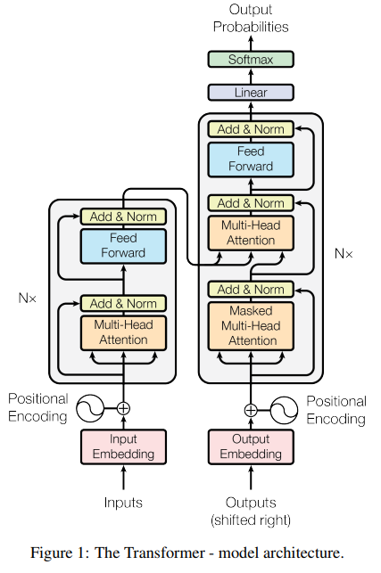
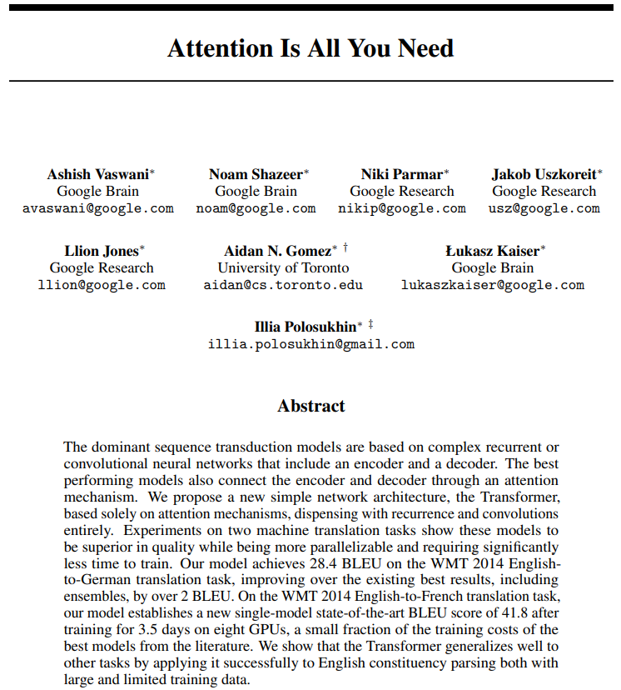
Transformer
Attention Is All You Need, A. Vaswani et al, 2017, https://arxiv.org/abs/1706.03762

Slide 4
NLP until 2017
Recurrent Neural Networks
Long Short-Term Memory (LSTM) networks
Gated Recurrent Units (GRU)
2017

Slide 5
NLP until 2017
Recurrent Neural Networks (RNNs)
Long Short-Term Memory (LSTM) networks
Gated Recurrent Units (GRU)
2017
Some advantages of RNNs (among others)
Efficient handling of sequential data types such as text, speech, and time series.
Ability to process inputs of variable lengths, a feature lacking in feedforward neural networks.
Enhanced training efficiency due to weight sharing across different time steps.

Slide 6
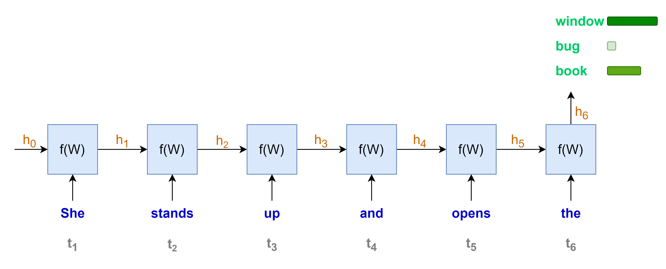
Language modeling with RNNs
“She stands up and opens the …………..”
Some disadvantages of RNNs (among others)
Sequential computation, one word at a time
→ Less rooms for parallel computation
→ Longer sequence, longer computation time

Slide 7
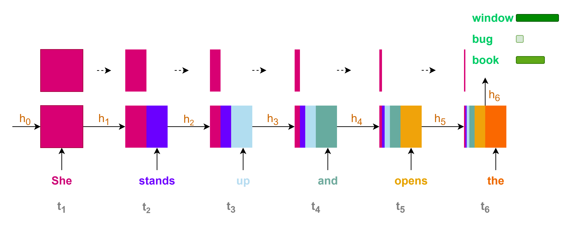
Language modeling with RNNs
Some disadvantages of RNNs (among others)
Contributions of initial states or information to the final state or prediction are very small for long sequence context
→ Loss of information for long-range dependencies

Slide 8
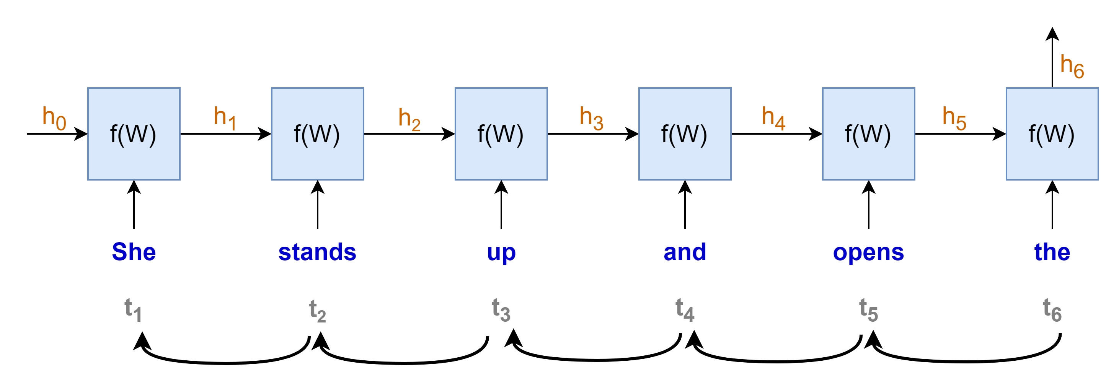
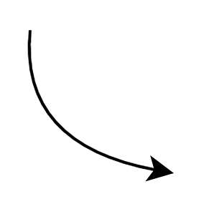
















Language modeling with RNNs
$$gradient products$$
$$\frac{∂h_{t}}{∂h_{t−1}}≪1 →very small→"vanished"$$
$$\frac{∂h_{t}}{∂h_{t−1}}≫1 →very large→"exploded"$$
$$\frac{∂h_{1}}{∂W}$$
$$\frac{∂h_{2}}{∂h_{1}}$$
$$\frac{∂h_{3}}{∂h_{2}}$$
$$\frac{∂h_{4}}{∂h_{3}}$$
$$\frac{∂h_{5}}{∂h_{4}}$$
$$\frac{∂h_{6}}{∂h_{5}}$$
$$×$$
$$×$$
$$×$$
$$×$$
$$×$$
$$\frac{∂L}{∂W}=\frac{∂L}{∂y}\frac{∂y}{∂h_{6}}$$
$$×$$
“chain rule”
Some disadvantages of RNNs (among others)
Training with Backpropagation Through Time
Vanishing or exploding gradients problems
hindering the learning process, especially for long sequences
making the training process highly unstable

Slide 9
NLP until 2017
Recurrent Neural Networks
Long Short-Term Memory (LSTM) networks
Gated Recurrent Units (GRU)
2017
Some disadvantages of RNNs (among others)
Sequential computation, hard to parallel computation with GPU
Loss of information for long-term dependencies
Vanishing or exploding gradient problems

Slide 10
The arrival of Transformer
2017
Recurrent Neural Networks
Long Short-Term Memory (LSTM) networks
Gated Recurrent Units (GRU)
Transformer
Some disadvantages of RNN
(among others)
Sequential computation, hard to parallel computation with GPU
Loss of information for long-term dependencies
Vanishing or exploding gradient problems

Slide 11


Transformer for lingual translation
Prediction:
"Je vais bien"
Transformer
Decoder
Encoder
Source:
"I am fine"
Simplified transformer architecture

Slide 12
The arrival of Transformer
2017
Recurrent Neural Networks
Long Short-Term Memory (LSTM) networks
Gated Recurrent Units (GRU)
Transformer
Some disadvantages of RNN
(among others)
Sequential computation, hard to parallel computation with GPU
Loss of information for long-term dependencies
Vanishing or exploding gradient problems
Transformer with self-attention mechanism
(among others)
Parallel computation → leverage GPU
Capture long-range dependencies
Less prone to vanishing or exploding gradient

Slide 13
NLP revolutions since 2017
2017
2018
Recurrent Neural Networks
Long Short-Term Memory (LSTM) networks
Gated Recurrent Units (GRU)
Transformer
Pre-trained language models
BERT
GPT
T5
PaLM
Llama
Mistral
Phi
Falcon
OLMo
…

Slide 15
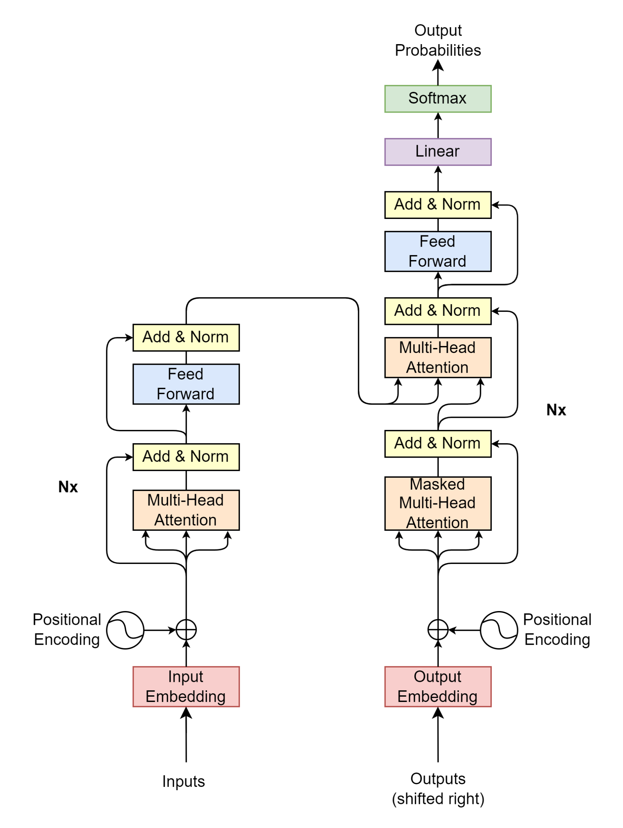

Transformer – Plan of attacks
What are Transformer block-by-block?
What are the input-output-process of each block?
Talk about input/output shape, type
Implement and playground with notebook for each block

Slide 17
Input block

Slide 18
What about text data
Source:
Target/Label:
"I am fine"
"Je vais bien"
"Thank you very much"
"Merci beaucoup"
"I cook French cuisine"
"Je fais la cuisine française"
Model only understand numerical value -> transform from text to numerical representation
Source and target texts may have different word length -> A fixed sequence length is needed for the model processing
Model need to know when to start and notify when to end its prediction

Slide 19
Text data → Model
Model only understands numerical value
Transform text to numerical representation
Source/target texts may have different lengths
A fixed sequence length is needed for model computation
When to start and to end model’s prediction
→ Find some ways to notify model when to start and to end a sequence

Slide 20
Tokenizer
Contain large vocabulary dictionary
Transform text to numerical representation
Special tokens
UNK: Unkown
PAD: Padding
SOS: Start Of Sentence
EOS: End Of Sentence
{
…
"vocab": {
"[UNK]": 0,
"[PAD]": 1,
"[SOS]": 2,
"[EOS]": 3,
"I" : 9,
"you": 24,
"very": 75,
"am" : 107,
"much": 120,
"fine": 550,
"French": 582
"cook": 1779,
"Thank": 2089,
}
…
}
tokenizer

Slide 21
Tokenizer – Source language – Encode
Tokenizer
encode
"I am fine"
[9, 107, 550]
{
…
"vocab": {
"[UNK]": 0,
"[PAD]": 1,
"[SOS]": 2,
"[EOS]": 3,
"I" : 9,
"you": 24,
"very": 75,
"am" : 107,
"much": 120,
"fine": 550,
"French": 582
"cook": 1779,
"Thank": 2089,
}
…
}
> text = "I am fine"
> tokenizer_source.encode(text).ids
# [9, 107, 550]
tokenizer_source

Slide 22
Tokenizer – Source language – Decode
Tokenizer
decode
[9, 107, 550]
"I am fine"
{
…
"vocab": {
"[UNK]": 0,
"[PAD]": 1,
"[SOS]": 2,
"[EOS]": 3,
"I" : 9,
"you": 24,
"very": 75,
"am" : 107,
"much": 120,
"fine": 550,
"French": 582
"cook": 1779,
"Thank": 2089,
}
…
}
> id_list = [9, 107, 550]
> tokenizer_source.decode(id_list)
# "I am fine"
tokenizer_source

Slide 23
Tokenizer – Target language - Encode
Tokenizer
encode
"Je vais bien"
[69, 600, 71]
{
…
"vocab": {
"[UNK]": 0,
"[PAD]": 1,
"[SOS]": 2,
"[EOS]": 3,
"la": 9,
"Je": 69 ,
"bien": 71,
"beaucoup": 324,
"vais": 600,
"fais": 1355,
"cuisine": 1390,
"Merci": 3546,
"française": 5309,
}
…
}
> text = "Je vais bien"
> tokenizer_target.encode(text).ids
# [69, 600, 71]
tokenizer_target

Slide 24
Tokenizer – Target language - Decode
Tokenizer
decode
[69, 600, 71]
"Je vais bien"
{
…
"vocab": {
"[UNK]": 0,
"[PAD]": 1,
"[SOS]": 2,
"[EOS]": 3,
"la": 9,
"Je": 69 ,
"bien": 71,
"beaucoup": 324,
"vais": 600,
"fais": 1355,
"cuisine": 1390,
"Merci": 3546,
"française": 5309,
}
…
}
> id_list = [69, 600, 71]
> tokenizer_target.decode(id_list)
# "Je vais bien"
tokenizer_target

Slide 25

Fixed sequence length – SOS, EOS, PAD
Source (max length: 4)
"I am fine"
"Thank you very much"
"I cook French cuisine"
Target (max length: 5)
"Je vais bien"
"Merci beaucoup"
"Je fais la cuisine française"
For decoder input
For loss calculation
For encoder input
SOS
I
am
fine
EOS
PAD
PAD
SOS
Thank
you
very
much
EOS
PAD
SOS
I
cook
French
cuisine
EOS
PAD
SOS
Je
vais
bien
PAD
PAD
PAD
SOS
Merci
beaucoup
PAD
PAD
PAD
PAD
SOS
Je
fais
la
cuisine
française
PAD
Je
vais
bien
EOS
PAD
PAD
PAD
Merci
beaucoup
EOS
PAD
PAD
PAD
PAD
Je
fais
la
cuisine
française
EOS
PAD
$seq$=7

Slide 26
Put it all together (1/3)
Source (max length: 4)
"I am fine"
"Thank you very much"
"I cook French cuisine"
Fixed length, SOS, EOS
For encoder input
SOS
I
am
fine
EOS
PAD
PAD
SOS
Thank
you
very
much
EOS
PAD
SOS
I
cook
French
cuisine
EOS
PAD
2
9
107
550
3
1
1
2
2089
95
75
120
3
1
2
9
1779
582
0
3
1
$seq$=7
Source Tokenizer
encodes

Slide 27
Put it all together (2/3)
Target (max length: 5)
"Je vais bien"
"Merci beaucoup"
"Je fais la cuisine française"
Fixed length, SOS, EOS
For encoder input
SOS
Je
vais
bien
PAD
PAD
PAD
SOS
Merci
beaucoup
PAD
PAD
PAD
PAD
SOS
Je
fais
la
cuisine
française
PAD
2
69
600
71
1
1
1
2
3546
324
1
1
1
1
2
69
1355
9
1390
5309
1
$seq$=7
Target Tokenizer
encodes

Slide 28
Put it all together (3/3)
Target (max length: 5)
"Je vais bien"
"Merci beaucoup"
"Je fais la cuisine française"
69 | 600 | 71 | 3 | 1 | 1 | 1
3546 | 324 | 3 | 1 | 1 | 1 | 1
69 | 1355 | 9 | 1390 | 5309 | 3 | 1
Fixed length, SOS, EOS
For encoder input
Je
vais
bien
EOS
PAD
PAD
PAD
Merci
beaucoup
EOS
PAD
PAD
PAD
PAD
Je
fais
la
cuisine
française
EOS
PAD
69
600
71
3
1
1
1
3546
324
3
1
1
1
1
69
1355
9
1390
5309
3
1
$seq$=7
Target Tokenizer
encodes

Slide 29
Transformer blocks
2
9
107
550
3
1
1
2
2089
95
75
120
3
1
2
9
1779
582
0
3
1
2
69
600
71
1
1
1
2
3546
324
1
1
1
1
2
69
1355
9
1390
5309
1

Slide 31
Transformer blocks
Projection
Decoder
Encoder
Encoder Input
Decoder Input

Slide 32



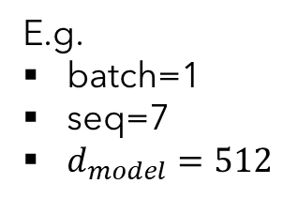



Encoder Input
Encoder Input
Positional
Encoding
$$\left(batch, seq, d_{model}\right)$$
E.g.
batch=1
seq=7
$d_{model}=512$
$$\left(batch, seq, d_{model}\right)$$
$$\left(batch, seq, d_{model}\right)$$
Input Embedding
Inputs
$$\left(batch, seq\right)$$
SOS
I
am
fine
EOS
PAD
PAD
2
9
107
550
3
1
1
"I am fine"

Slide 33
Input Embedding
E.g.
batch=1
seq=7
$d_{model}=512$
$$\left(batch, seq, d_{model}\right)$$
Input Embedding
Inputs
$$\left(batch, seq\right)$$
SOS
I
am
fine
EOS
PAD
PAD
2
9
107
550
3
1
1
"I am fine"

Slide 34



Input Embedding
$$d_{model}$$
… | … | … | … | …
523.415 | 1265.142 | … | 4189.251 | 16.416
452.716 | 6234.624 | … | 412.414 | 1794.127
7745.984 | 1314.124 | … | 65.764 | 1543.345
… | … | … | … | …
… | … | … | … | …
… | … | … | … | …
$$seq$$
E.g.
batch=1
seq=7
$d_{model}=512$
$$\left(batch, seq, d_{model}\right)$$
Input Embedding
Inputs
$$\left(batch, seq\right)$$
SOS
I
am
fine
EOS
PAD
PAD
2
9
107
550
3
1
1
"I am fine"
$$seq$$

Slide 35













Positional Encoding
$$d_{model}$$
$$i=0$$
$$i=1$$
$$⋯$$
$$i=d_{model}−1$$
… | … | … | … | …
PE(1,0) | PE(1,1) | … | PE(1,510) | PE(1, 511)
PE(2,0) | PE(2,1) | … | PE(2,510) | PE(2, 511)
PE(3,0) | PE(3,1) | … | PE(3,510) | PE(3, 511)
… | … | … | … | …
… | … | … | … | …
… | … | … | … | …
$$pos=0$$
$pos=$1
$$⋮$$
$$seq$$
E.g.
batch=1
seq=7
$d_{model}=512$
$$pos$$
$$=seq−1$$
$$\left(batch, seq, d_{model}\right)$$
PE$\left(pos, 2i\right)=\sin\left(\frac{pos}{{10000}^{\frac{2i}{d_{model}}}}\right)$
Positional
Encoding
PE$\left(pos, 2i+1\right)=\cos\left(\frac{pos}{{10000}^{\frac{2i}{d_{model}}}}\right)$
Inputs
$$\left(batch, seq\right)$$
SOS
I
am
fine
EOS
PAD
PAD
2
9
107
550
3
1
1
"I am fine"
$$seq$$

Slide 36
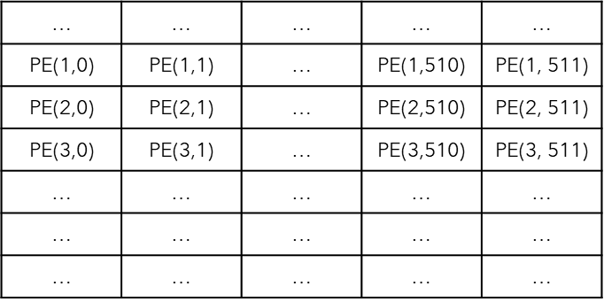
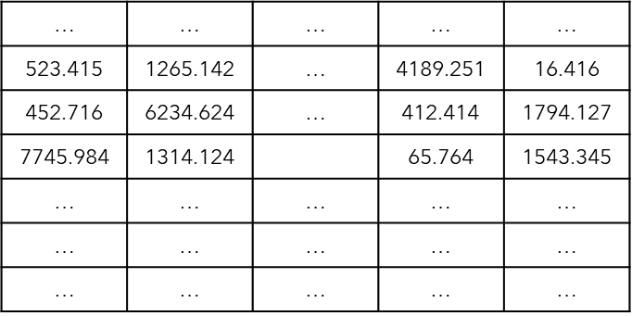








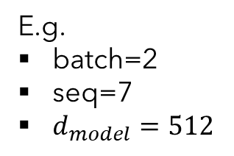


Encoder Input
Encoder Input
E.g.
batch=2
seq=7
$d_{model}=512$
Positional
Encoding
$$\left(batch, seq, d_{model}\right)$$
$$\left(batch, seq, d_{model}\right)$$
$$d_{model}$$
$$\left(batch, seq, d_{model}\right)$$
Input Embedding
$$seq$$
Inputs
$$batch$$
$$\left(batch, seq\right)$$
SOS
I
am
fine
EOS
PAD
PAD
SOS
Thank
you
very
much
EOS
PAD
2
9
107
550
3
1
1
2
2089
95
75
120
3
1
$$batch$$
$$batch$$
"I am fine"
"Thank you very much"
$$seq$$

Slide 37
Transformer blocks
Projection
Decoder
Encoder
Encoder Input
Decoder Input

Slide 38
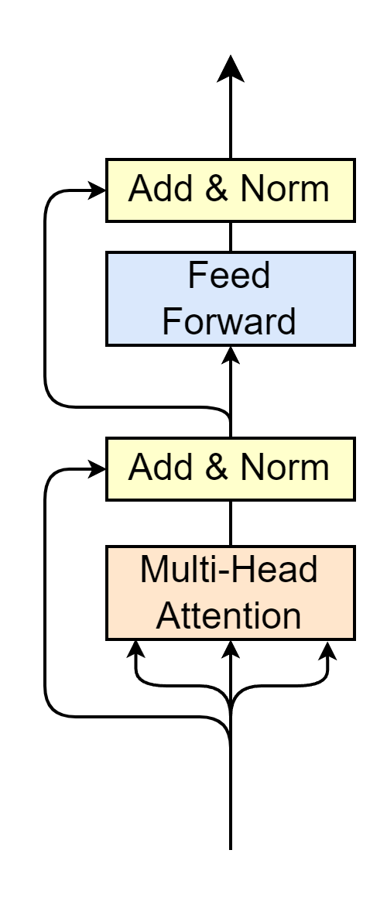



Encoder
Encoder Output
$$\left(batch, seq, d_{model}\right)$$
Multi-Head Attention
Self-Attention
Layer Normalization
Feed Forward
Residual connection
Residual Connection
$$N_{x}$$
… | … | … | … | …
1813.456 | 1665.569 | … | 5327.367 | 435.167
652.881 | 2434.715 | … | 846.846 | 2678.246
8945.944 | 2413.412 | … | 842.416 | 1964.597
… | … | … | … | …
… | … | … | … | …
… | … | … | … | …
… | … | … | … | …
523.415 | 1265.142 | … | 4189.251 | 16.416
452.716 | 6234.624 | … | 412.414 | 1794.127
7745.984 | 1314.124 |  | 65.764 | 1543.345
… | … | … | … | …
… | … | … | … | …
… | … | … | … | …
Encoder Input
$$\left(batch, seq, d_{model}\right)$$

Slide 39
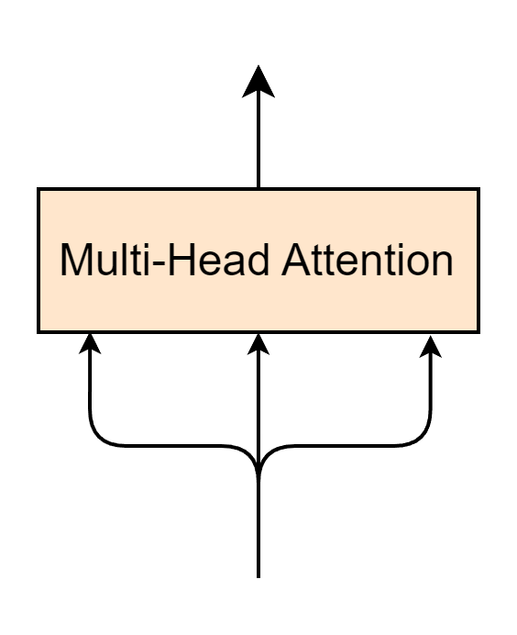
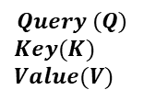









Multi-Head Attention Layer
$$\left(batch, seq, d_{model}\right)$$
$$Q$$
$$K$$
$$V$$
… | … | … | … | …
1813.456 | 1665.569 | … | 5327.367 | 435.167
652.881 | 2434.715 | … | 846.846 | 2678.246
8945.944 | 2413.412 | … | 842.416 | 1964.597
… | … | … | … | …
… | … | … | … | …
… | … | … | … | …
Encoder Input
… | … | … | … | …
523.415 | 1265.142 | … | 4189.251 | 16.416
452.716 | 6234.624 | … | 412.414 | 1794.127
7745.984 | 1314.124 |  | 65.764 | 1543.345
… | … | … | … | …
… | … | … | … | …
… | … | … | … | …
$$\left(batch, seq, d_{model}\right)$$
$$Query \left(Q\right)$$
$$Key(K)$$
$$Value(V)$$
$$seq$$
$$≡$$
$$batch$$
$$d_{model}$$

Slide 40
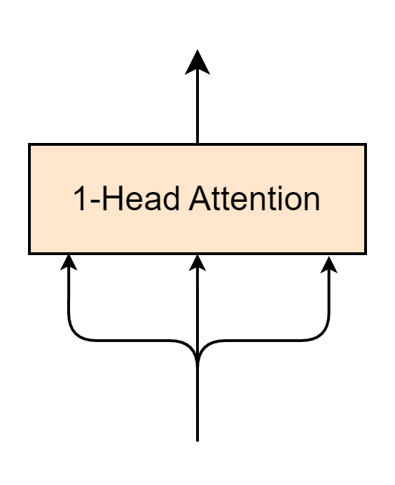

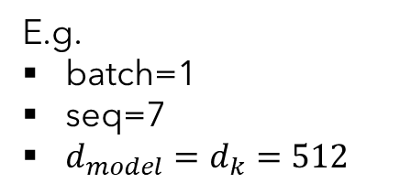

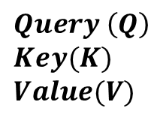
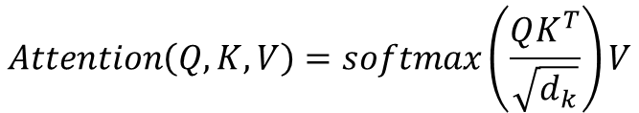





1-Head Attention Layer
E.g.
batch=1
seq=7
$d_{model}=d_{k}=512$
$$\left(batch, seq, d_{model}\right)$$
$$Attention\left(Q, K, V\right)=softmax\left(\frac{QK^{T}}{\sqrt{d_{k}}}\right)V$$
$$Q$$
$$K$$
$$V$$
Encoder Input
$$\left(batch, seq, d_{model}\right)$$
… | … | … | … | …
1813.456 | 1665.569 | … | 5327.367 | 435.167
652.881 | 2434.715 | … | 846.846 | 2678.246
8945.944 | 2413.412 | … | 842.416 | 1964.597
… | … | … | … | …
… | … | … | … | …
… | … | … | … | …
$$Query \left(Q\right)$$
$$Key(K)$$
$$Value(V)$$
$$seq$$
$$≡$$
$$d_{model}$$

Slide 41

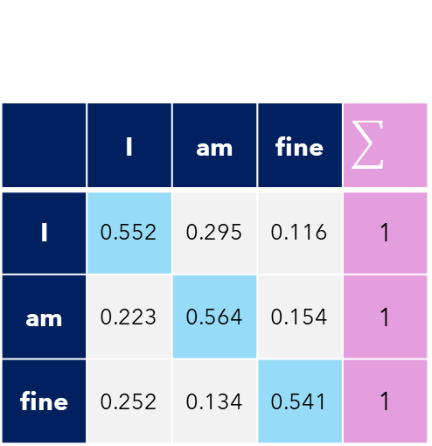

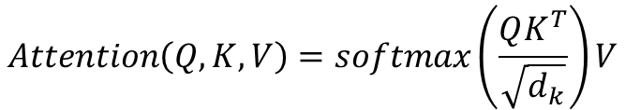




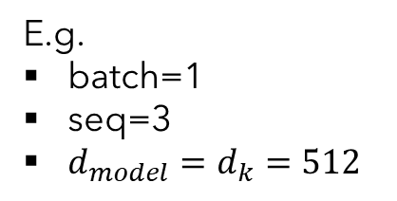

Self-Attention
Self-Attention
E.g.
batch=1
seq=3
$d_{model}=d_{k}=512$
$$Attention\left(Q, K, V\right)=softmax\left(\frac{QK^{T}}{\sqrt{d_{k}}}\right)V$$
$$Q(3, 512)$$
$$K^{T}(512,3)$$
1813.456 | 652.881 | 8945.944
1665.569 | 2434.715 | 2413.412
… | … | …
5327.367 | 846.846 | 842.416
435.167 | 2678.246 | 1964.597
Self-Attention$(3,3)$
1813.456 | 1665.569 | … | 5327.367 | 435.167
652.881 | 2434.715 | … | 846.846 | 2678.246
8945.944 | 2413.412 | … | 842.416 | 1964.597
$$softmax$$
$$×$$
 | I | am | fine
I | 0.552 | 0.295 | 0.116 | 1
am | 0.223 | 0.564 | 0.154 | 1
fine | 0.252 | 0.134 | 0.541 | 1
$$=$$
$$\sqrt{512}$$
Self-attention -> Relate words to each others

Slide 42





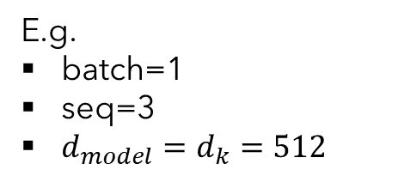

1-Head Attention Layer
Self-Attention
E.g.
batch=1
seq=3
$d_{model}=d_{k}=512$
$$Attention\left(Q, K, V\right)=softmax\left(\frac{QK^{T}}{\sqrt{d_{k}}}\right)V$$
Self-Attention$(3,3)$
 | I | am | fine
I | 0.552 | 0.295 | 0.116 | 1
am | 0.223 | 0.564 | 0.154 | 1
fine | 0.252 | 0.134 | 0.541 | 1
V$(3, 512)$
Attention$(3, 512)$
1813.456 | 1665.569 | … | 5327.367 | 435.167
652.881 | 2434.715 | … | 846.846 | 2678.246
8945.944 | 2413.412 | … | 842.416 | 1964.597
… | … | … | … | …
… | … | … | … | …
… | … | … | … | …
$$×$$
$$=$$
"Word meaning + position feature"
"Word meaning + position feature"
"Relate words to each others"
"Relate words to each others"

Slide 43
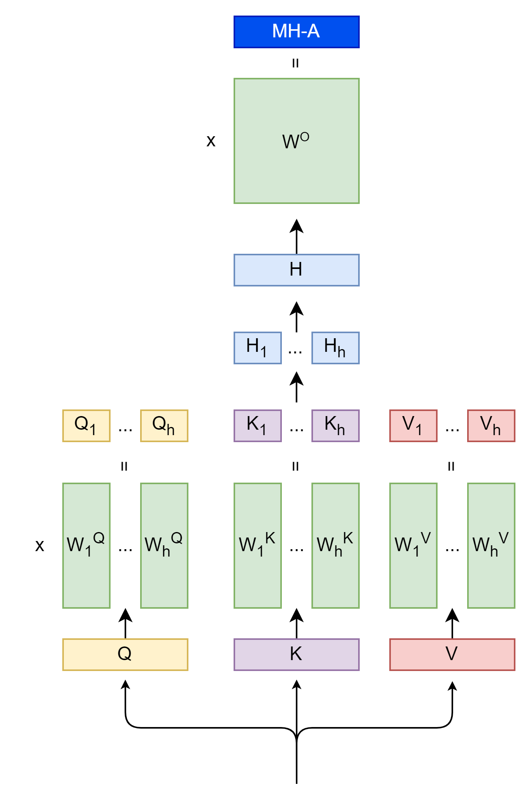
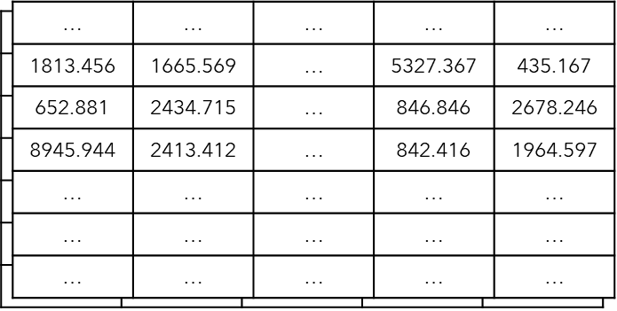










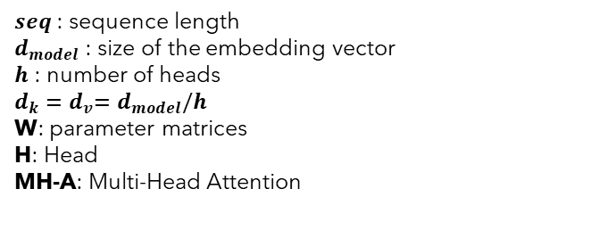




Multi-Head Attention
$$Attention\left(Q, K, V\right)=softmax\left(\frac{QK^{T}}{\sqrt{d_{k}}}\right)V$$
$$\left(batch, seq, d_{model}\right)$$
$seq$ : sequence length
$d_{model}$ : size of the embedding vector
$h$ : number of heads
$d_{k}{=d}_{v}=d_{model}/h$
W: parameter matrices
H: Head
MH-A: Multi-Head Attention
$$\left(batch,d_{model}, d_{model}\right)$$
$$Concat\left(head_{1},⋯,head_{h}\right)$$
$$\left(batch, seq, d_{model}\right)$$
$${Head}_{i}=Attention\left(QW_{i}^{Q},KW_{i}^{K},VW_{i}^{V}\right)$$
$$\left(batch, seq, d_{v}\right)$$
$$\left(batch, seq, d_{k}\right)$$
$$\left(batch,d_{model}, d_{k}\right)$$
$$batch$$
$$d_{model}$$
$$\left(batch, seq, d_{model}\right)$$
$$seq$$
Encoder Input
$$\left(batch, seq, d_{model}\right)$$

Slide 44
Encoder
Encoder Output
$$\left(batch, seq, d_{model}\right)$$
Multi-Head Attention
Self-Attention
Layer Normalization
Feed Forward
Residual connection
Residual Connection
$$N_{x}$$
Encoder Input
$$\left(batch, seq, d_{model}\right)$$

Slide 45

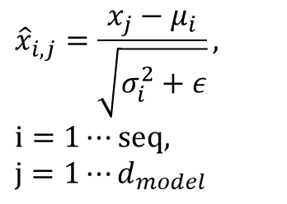

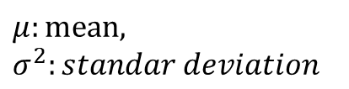



Layer Normalization
$${\hat{x}}_{i,1}$$
$${\hat{x}}_{{i,d}_{model}}$$
 |  | …
$${\hat{x}}_{i,j}=\frac{x_{j}−μ_{i}}{\sqrt{σ_{i}^{2}+ε}},$$
$$i=1⋯seq,$$
$$j=1⋯d_{model}$$
Layer Normalization
$$μ:mean,$$
$$σ^{2}:standar deviation$$
$$Token_{i}$$
$$x_{i,1}$$
$$x_{{i,d}_{model}}$$
 |  | …

Slide 46
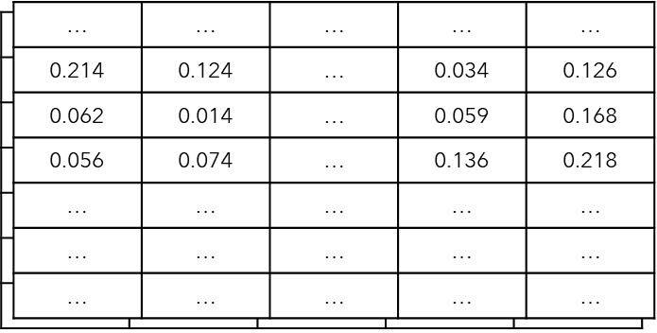

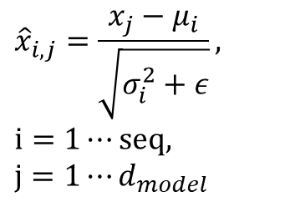


Layer Normalization
$$\left(batch, seq,d_{model}\right)$$
$${\hat{x}}_{i,j}=\frac{x_{j}−μ_{i}}{\sqrt{σ_{i}^{2}+ε}},$$
$$i=1⋯seq,$$
$$j=1⋯d_{model}$$
Layer Normalization
$$\left(batch, seq,d_{model}\right)$$
$$batch$$
$$seq$$
$$d_{model}$$

Slide 47
Encoder
Encoder Output
$$\left(batch, seq, d_{model}\right)$$
Multi-Head Attention
Self-Attention
Layer Normalization
Feed Forward
Residual connection
Residual Connection
$$N_{x}$$
Encoder Input
$$\left(batch, seq, d_{model}\right)$$

Slide 48
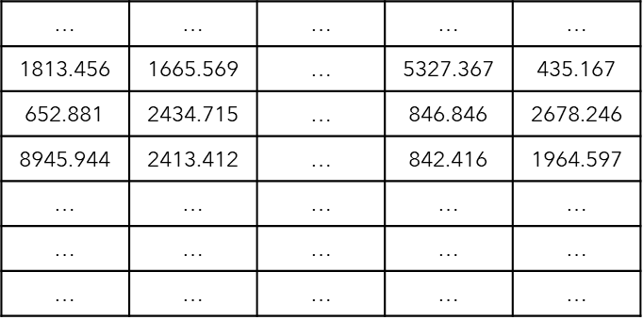



















Feed Forward
$$W_{1}$$
$$W_{2}$$
$$FFN\left(x\right)=$$
$$x$$
$$×$$
$$+$$
$$b_{1}$$
$$×$$
$$+$$
$$b_{2}$$
$$ReLU$$
$$\left(seq,d_{model}\right)$$
$$\left(d_{model},d_{ff}\right)$$
$$\left(d_{ff},d_{model}\right)$$
$$Linear Layer 1$$
$$\left(seq,d_{ff}\right)$$
$$Linear Layer 2$$
$$\left(seq,d_{model}\right)$$
$$x\left(seq,d_{model}\right)$$
$$seq$$
$$FFN\left(x\right)=max\left(0, xW_{1}+b_{1}\right)W_{2}+b_{2}$$
$$d_{model}$$

Slide 49
Encoder
Encoder Output
$$\left(batch, seq, d_{model}\right)$$
Multi-Head Attention
Self-Attention
Layer Normalization
Feed Forward
Residual connection
Residual Connection
$$N_{x}$$
Encoder Input
$$\left(batch, seq, d_{model}\right)$$

Slide 50




Residual Connection
$$output=x+sublayer(x)$$
$$+$$
$$Sublayer$$
$$x$$

Slide 51

Encoder
Encoder Output
$$\left(batch, seq, d_{model}\right)$$
Multi-Head Attention
Self-Attention
Layer Normalization
Feed Forward
Residual connection
Residual Connection
$N_{x}$=6
Encoder Input
$$\left(batch, seq, d_{model}\right)$$

Slide 52
Decoder
Projection
Decoder
Encoder
Encoder Input
Decoder Input

Slide 53
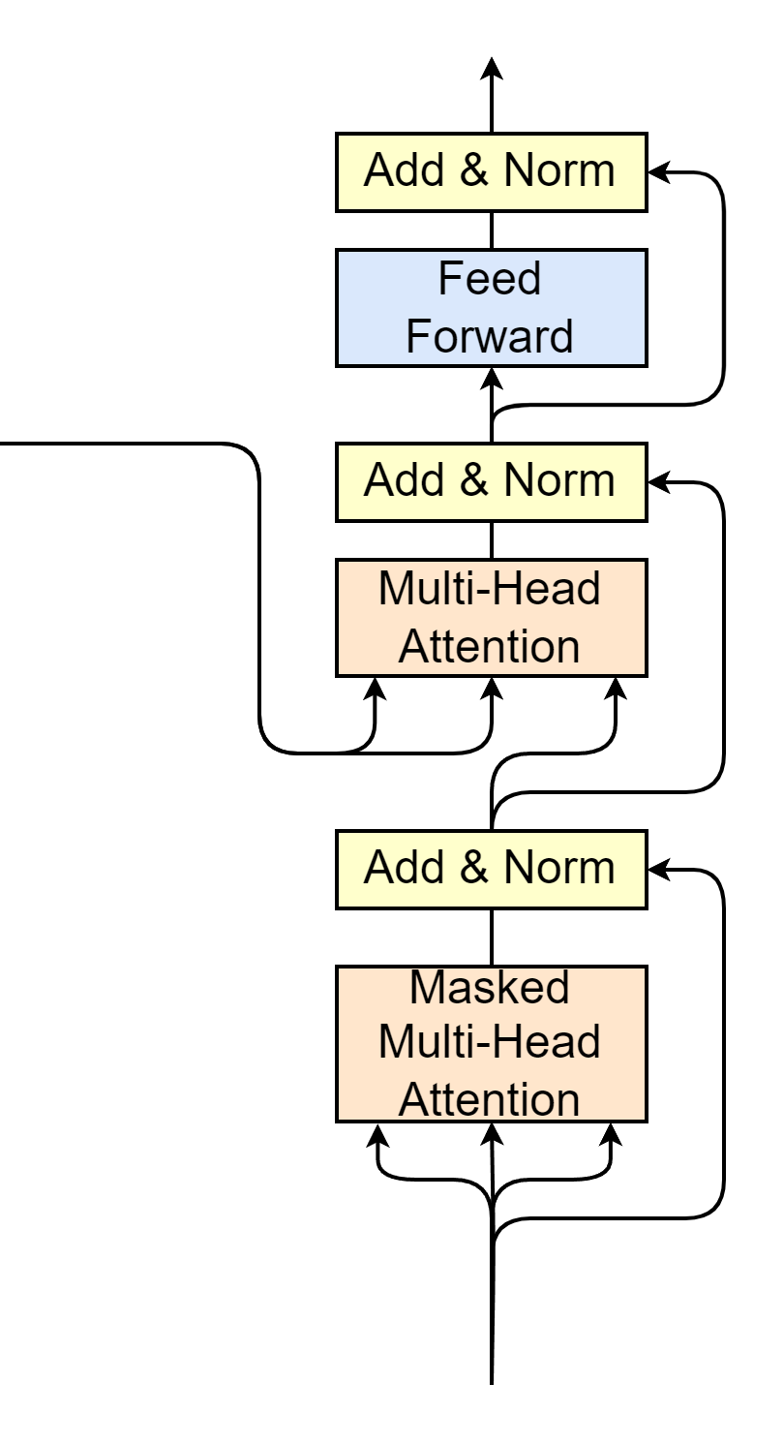






Decoder
Encoder output as Q and K of Multi-Head Attention
Masked Multi-Head Attention
Encoder Output
$$\left(batch, seq, d_{model}\right)$$
$$K$$
$$V$$
$$Q$$
$$N_{x}$$
Decoder Input
$$\left(batch, seq_{decoder}, d_{model}\right)$$

Slide 54
Masked Multi-Head Attention
 | This | Team | Is | The | Best | Team
This | 0.252 | 0.195 | 0.116 | 0.182 | 0.147 | 0.108
team | 0.123 | 0.264 | 0.154 | 0.165 | 0.172 | 0.122
Is | 0.152 | 0.134 | 0.241 | 0.156 | 0.154 | 0.163
The | 0.136 | 0.152 | 0.121 | 0.255 | 0.154 | 0.182
Best | 0.164 | 0.141 | 0.106 | 0.184 | 0.295 | 0.110
Team | 0.175 | 0.169 | 0.122 | 0.123 | 0.153 | 0.258

Slide 55






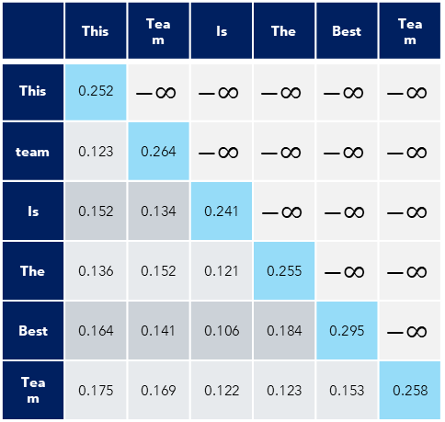


Masked Multi-Head Attention
$$Attention\left(Q, K, V\right)=softmax\left(\frac{QK^{T}}{\sqrt{d_{k}}}\right)V$$
 | This | Team | Is | The | Best | Team
This | 0.252 | $$−∞$$ | $$−∞$$ | $$−∞$$ | $$−∞$$ | $$−∞$$
team | 0.123 | 0.264 | $$−∞$$ | $$−∞$$ | $$−∞$$ | $$−∞$$
Is | 0.152 | 0.134 | 0.241 | $$−∞$$ | $$−∞$$ | $$−∞$$
The | 0.136 | 0.152 | 0.121 | 0.255 | $$−∞$$ | $$−∞$$
Best | 0.164 | 0.141 | 0.106 | 0.184 | 0.295 | $$−∞$$
Team | 0.175 | 0.169 | 0.122 | 0.123 | 0.153 | 0.258
$$\left(batch, seq, d_{model}\right)$$
$seq$ : sequence length
$d_{model}$ : size of the embedding vector
$h$ : number of heads
$d_{k}{=d}_{v}=d_{model}/h$
W: parameter matrices
H: Head
MH-A: Multi-Head Attention
$$\left(batch,d_{model}, d_{model}\right)$$
$$Concat\left(head_{1},⋯,head_{h}\right)$$
$$\left(batch, seq, d_{model}\right)$$
$${Head}_{i}=Attention\left(QW_{i}^{Q},KW_{i}^{K},VW_{i}^{V}\right)$$
$$\left(batch, seq, d_{v}\right)$$
$$\left(batch, seq, d_{k}\right)$$
$$\left(batch,d_{model}, d_{k}\right)$$
$$batch$$
$$d_{model}$$
$$\left(batch, seq, d_{model}\right)$$
$$seq$$
Encoder Input
$$\left(batch, seq_{decoder}, d_{model}\right)$$

Slide 56


Decoder
Decoder Output
$$\left(batch, seq, d_{model}\right)$$
Encoder output as Q and K of Multi-Head Attention
Masked Multi-Head Attention
Encoder Output
$$\left(batch, seq, d_{model}\right)$$
$$K$$
$$V$$
$$Q$$
$N_{x}$=6
Decoder Input
$$\left(batch, seq_{decoder}, d_{model}\right)$$

Slide 57
Projection & Transformer Output
Projection
Decoder
Encoder
Encoder Input
Decoder Input

Slide 58
Projection & Transformer Output
Projection: Linear layer
Softmax
Projection
Decoder
Encoder
Encoder Input
Decoder Input

Slide 59
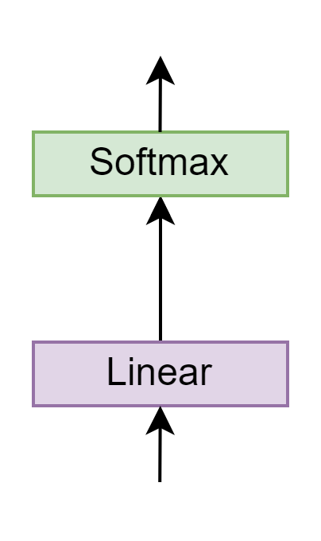




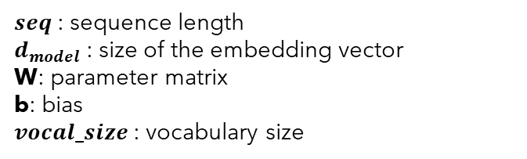









Projection
Target Tokenizer
$seq$ : sequence length
$d_{model}$ : size of the embedding vector
W: parameter matrix
b: bias
$vocal_size$: vocabulary size
{
…
"vocab": {
"[UNK]": 0,
"[PAD]": 1,
"[SOS]": 2,
"[EOS]": 3,
"la": 9,
"Je": 69 ,
"bien": 71,
"beaucoup": 324,
"vais": 600,
"fais": 1355,
"cuisine": 1390,
"Merci": 3546,
"française": 5309,
}
…
}
$$\left(batch, seq_{decoder},vocal_size\right)$$
$$\left(batch, seq_{decoder},vocal_size\right)$$
$$vocal_size=10000$$
$$W$$
Decoder Output
$$x$$
$$Linear\left(x\right)=$$
$$x$$
$$×$$
$$+$$
$$b$$
$$\left(batch, seq_{decoder}, d_{model}\right)$$
$$\left(seq,d_{model}\right)$$
$$\left(d_{model},vocal_size\right)$$

Slide 60
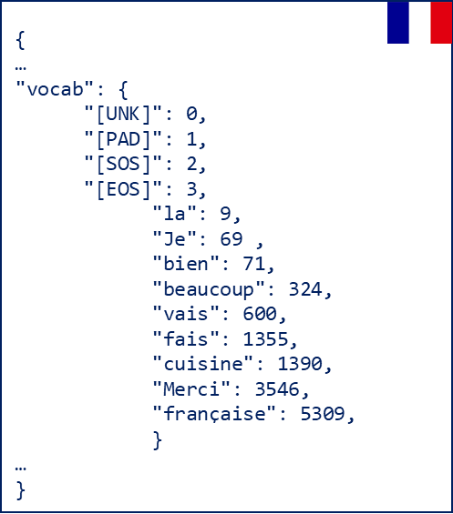
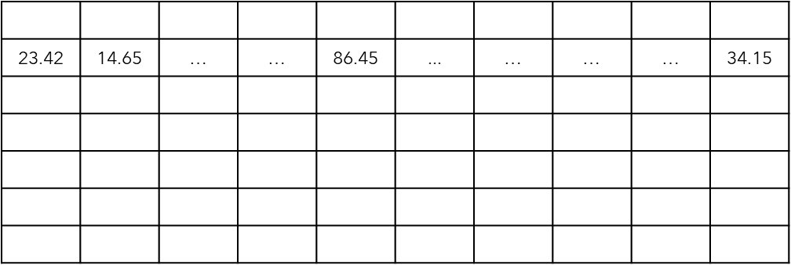
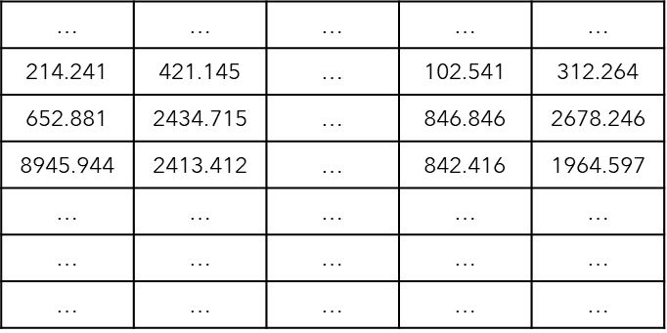








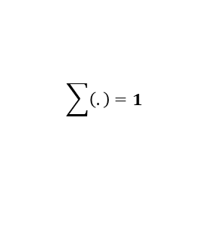

Transformer output example
Target Tokenizer
Je
decode
Softmax
$$index_{max}=69$$
$$vocal_size=10000$$
$$seq=7$$
0.03 | 0.04 | … | … | 0.86 | ... | … | … | … | 0.04
$$\sum{\left(.\right)}=1$$
$$vocal_size=10000$$
Linear
$$len=10000$$
3.42 | 4.65 | … | … | 86.45 | ... | … | … | … | 4.15
$$seq=7$$
$$len=10000$$
214.241 | 421.145 | … | 102.541 | 312.264
$$d_{model}=512$$
$$len=512$$

Slide 61

Transformer blocks
Projection
Decoder
Great Job!!
Encoder
Encoder Input
Decoder Input

Slide 62
Inference
t1
Je
Decoder
Encoder
<SOS> I am fine <EOS>
<SOS>
Source:
"I am fine"

Slide 63
Inference
t2
Je
Decoder
Encoder
<SOS> I am fine <EOS>
<SOS>
Source:
"I am fine"

Slide 64
Inference
t2
vais
Decoder
Encoder
<SOS> I am fine <EOS>
<SOS> Je
Source:
"I am fine"

Slide 65
Inference
t3
vais
Decoder
Encoder
<SOS> I am fine <EOS>
<SOS> Je
Source:
"I am fine"

Slide 66
Inference
t3
bien
Decoder
Encoder
<SOS> I am fine <EOS>
<SOS> Je vais
Source:
"I am fine"

Slide 67
Inference
t4
bien
Decoder
Encoder
<SOS> I am fine <EOS>
<SOS> Je vais
Source:
"I am fine"

Slide 68
Inference
t4
Prediction:
"Je vais bien"
EOS
Decoder
Encoder
<SOS> I am fine <EOS>
<SOS> Je vais bien
Source:
"I am fine"

Slide 69
Training
Target:
"Je vais bien"
t1
Je vais bien <EOS>
Cross Entropy Loss
X Y Z
Decoder
Encoder
Update model parameters
<SOS> I am fine <EOS>
<SOS> Je vais bien
Source:
Target:
"I am fine"
"Je vais bien"

Slide 70
Training
Target:
"Je t'aime"
t2
Je t'aime <EOS>
Cross Entropy Loss
A B C
Decoder
Encoder
Update model parameters
<SOS> I am fine <EOS>
<SOS> Je t'aime
Source:
Target:
"I love you"
"Je t'aime"

